Slide 1
What is Systems Engineering
Dr. Siddhartha Agarwal
MND 404

Slide 2
System Definitions
System - A combination of elements forming a complex whole
System’s Function (Purposeful Action) - A system is a set of interrelated components working together toward some common objective or purpose
Systems Engineers deal with man-made systems

Slide 3
System Definition
Systems and Subsystems
Systems, segments, subsystems, elements
Environment
Inputs/Outputs
Throughput – what is being transformed within the system!
Defined at System Boundaries
Notes:
Components is sometimes also used in the hierarchy, but more commonly refer to individual electrical components like resistors, capacitors, etc.

Slide 4
System Classification
Natural vs. Human–Made Systems
Physical vs. Conceptual Systems
Static vs. Dynamic Systems
Closed vs. Open Systems
Consider Examples – Do they have more than one applicable classification?
Key Takeaway: Precision of terms is crucial
Most useful SE tool: Diagramming a sentence
That is: Precision of usage, too

Slide 5
Evolution of Systems Engineering
After World War II, Systems Engineering began to evolve as a branch of engineering as the military services and prime contractors sought tools and techniques that would help them excel at:
System performance and mission success
Project management: technical performance, delivery schedule, and cost control
Space Age – more complex systems needed higher reliability
Computer Age – connected more systems into Systems of Systems and Networked Systems
Now we call them Cyber Physical Systems
Notes:
CPM defines the critical path in the schedule; Theory of Constraints looks for similar things, but in more than just schedule
PERT- the Program Evaluation Review Technique used by the U.S. Navy during Polaris A1 development was one of the first major tools
CPM – Critical Path Method, developed for commercial projects

Slide 6
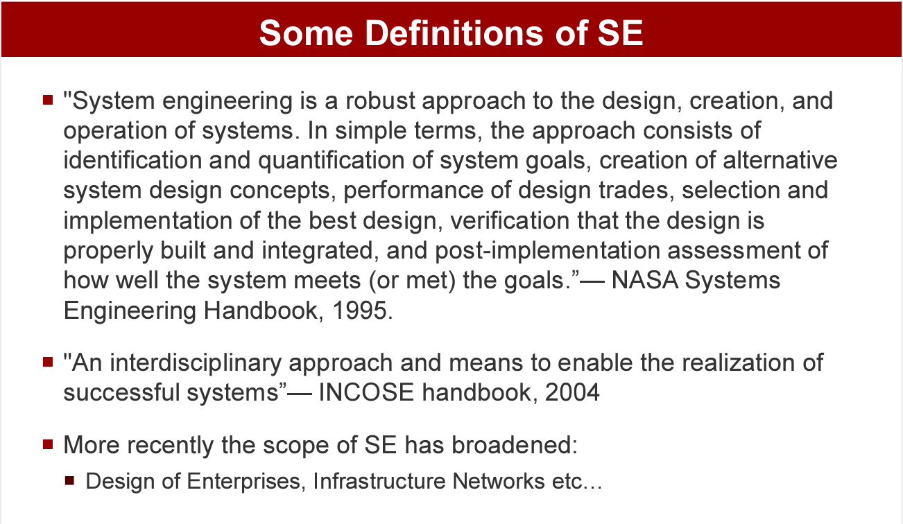

Slide 7
Systems Engineering
An interdisciplinary approach
A means to enable the realization of successful systems
By defining customer needs and required functionality early in the development cycle
Systems engineers are responsible for
Design and management of complex systems, guided by systems requirements
There is a growing need for engineers who are
Concerned with the whole system
Can take an interdisciplinary and top down approach
Systems engineers need to be
Problem definers, not just problem solvers
Involved with a system throughout its entire life cycle, from development through production, deployment, training, support, operation, and disposal

Slide 8
EMERGENCE
Those collective properties—often called “emergent properties”—are critical attributes of biological systems, as understanding the individual parts alone is insufficient to understand or predict system behaviour. Thus, emergent properties necessarily come from the interactions of the parts of the larger system.
Examples of emergent properties include cities, the brain, ant colonies and complex chemical systems
"The whole is greater than the sum of its parts” – Aristotle.

Slide 9
Ant Colonies
A single ant is a rather limited organism, with little ability to reason or accomplish complex tasks.
As a whole, however, an ant colony accomplishes astounding tasks, from building hills and dams to finding and moving huge amounts of food.
In this context, emergent properties are the changes that occur in ant behavior when individual ants work together.
Alone, an ant behaves erratically and almost at random. But millions of random actions by thousands and thousands of ants can serve to identify necessary tasks and organize other ants to complete them.

Slide 10
The Brain: Human consciousness
Human consciousness is often called an emergent property of the human brain.
Like the ants that make up a colony, no single neuron holds complex information like self-awareness, hope or pride.
Nonetheless, the sum of all neurons in the nervous system generate complex human emotions like fear and joy, none of which can be attributed to a single neuron.
Although the human brain is not yet understood enough to identify the mechanism by which emergence functions, most neurobiologists agree that complex interconnections among the parts give rise to qualities that belong only to the whole.

Slide 11
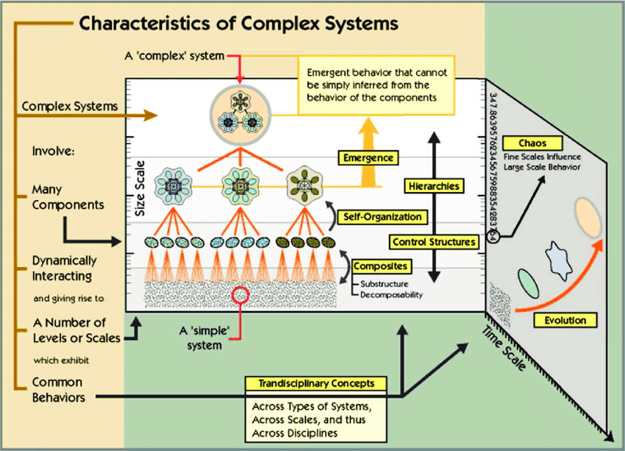
Complex Systems
Systems that are "complex" have distinct properties that arise from these relationships, such as nonlinearity, emergence, adaptation (response to environmental change), and feedback loops, among others.

Slide 12
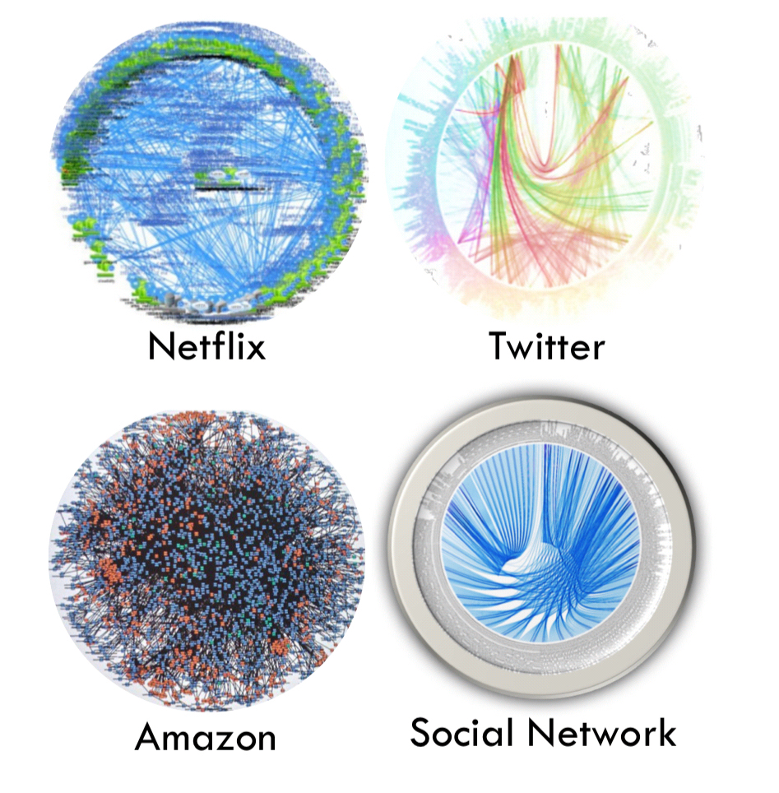
Network Examples of Complex Systems

Slide 13
Complex Systems
Examples of complex systems include ant-hills, ants themselves, human economies, climate, nervous systems, cells and living things, including human beings, as well as modern energy or telecommunication infrastructures

Slide 14
System Elements
Components – operating parts of the system described by input, process, and output
Elements of the system perform functions that perform the processes
Attributes – properties of the components, or of the system under consideration
Relationships – links between components and attributes

Slide 15
System Components
The properties and behaviors of each component (or subset) of the system:
Have an effect on the properties and behaviors of the system as a whole
Impact depends on the properties and behaviors of at least one other component in the set
Components cannot be divided into completely independent subsets

Slide 16
System Components
Structural Components - Static, but still perform an operation (or function)
Operating Components - Perform processing or control (do or change something)
Flow Components - Material, energy or information being altered

Slide 17
Examples of Systems
Fire Department
University
Interstate Highway System
Utilities (Gas, Water, Electric, Phone, Cable, Internet)
Computer
Cruise ship
Aircraft
Corporation
Swamp…Desert…Tree
Subsystems or… SoS?
Environment?
Inputs?
Outputs?
Throughput?
Notes:
Depends what the context is

Slide 18


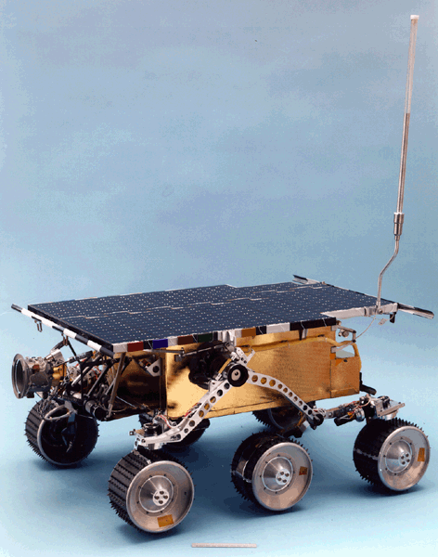

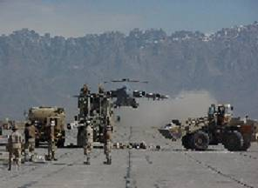
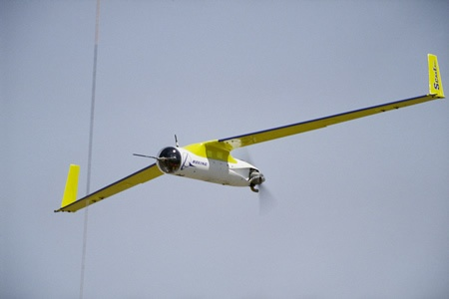

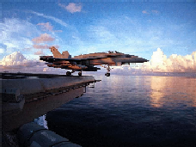
Examples of Developed System Artifacts
F/A -18
Boeing 787
Insulin Pump
Mars Rover
F/A-18F
B1-B
USS Gerald R. Ford
C-17
ScanEagle

Slide 19
System Engineering
Systems Engineering is a top-down, life-cycle approach
to the design, development, and deployment of
large-scale systems, processes, or operations to meet
the effective needs of users and stakeholders in a
cost-effective, high-quality way.
An organised and systematic way of design
Considers all the factors involved in the design
Integrates all the disciplines and specialty groups
into a team effort
Ensures the business and customer needs of all
stakeholders and ensures a system that meets the
user needs

Slide 20
Engineering
The process of devising a system, component, or process to meet desired needs. It is a decision-making process (often iterative) in which the basic sciences, mathematics, and engineering sciences are applied to convert resources optimally to meet a stated objective.
–Accreditation Board for Engineering and Technology

Slide 21
Then, What is a System?
a. A group of interacting, interrelated, or interdependent elements forming a complex whole.
b. A functionally related group of elements, : The human body regarded as a functional physiological unit.
c. An organism as a whole, especially with regard to its vital processes or functions.
d. A group of physiologically or anatomically complementary organs or parts: the nervous system; the skeletal system.
e. A group of interacting mechanical or electrical components.
f. A network of related computer software, hardware, and data transmission devices.

Slide 22
A system is commonly defined to be a collection of hardware, software, people, facilities, and procedures organised to accomplish some common objectives.

Slide 23
Definition of a System (NASA Systems Engineering Handbook)
A system is a set of interrelated components which interact with one another in an organized fashion toward a common purpose.
System components may be quite diverse
Persons and Organizations
Software and Data
Equipment and Hardware
Facilities and Materials
Services and Techniques

Slide 24
Systems Engineering
Definition of Systems Engineering (NASA SE Handbook)
Systems Engineering is a robust approach to the design, creation, and operation of systems.
Systems Engineering consists of
Identification and quantification of system goals
Creation of alternative system design concepts
Performance of design trades
Selection and implementation of the best design (balanced and robust)
Verification that the design is actually built and properly integrated
in accordance with specifications
Assessment of how well the system meets the goals

Slide 25
What is Systems Engineering?
Systems Engineering is a top-down, life-cycle approach to the design, development, and deployment of large-scale systems, processes, or operations to meet the effective needs of users and stakeholders in a cost-effective, high-quality way.
Systems Engineering typically involves an interdisciplinary approach and means to enable the realization of successful systems.
It focuses on defining customer needs and required functionality early in the development cycle, documenting requirements, then proceeding with design synthesis and system validation while considering the complete problem.

Slide 26
Building Blocks of Systems Engineering
Math & Physical Sciences
Qualitative modeling
Quantitative modeling
Physical modeling
Theory of Constraints
Physical Laws
Management Sciences
Economics
Organizational Design
Business Decision Analysis
Operations Research
Unique to Systems Engineering

Slide 27
Building Blocks of Systems Engineering
Social Sciences
Multi-disciplinary Teamwork
Organizational Behavior
Leadership
Body of Knowledge
Problem definition
System boundaries
Objectives hierarchy
Concept of operations
Originating requirements
Concurrent engineering
System life cycle phases
Integration/Qualification
- Architectures
Functional/Logical
Physical/Operational
Interface
- Trades
Concept-level
Risk management
Key performance
parameters
Unique to Systems Engineering

Slide 28
Other Considerations
Achieving balance between inherent conflicts
System functionality and performance
Development cost and recurring cost
Development schedule (Time to Market)
Development risk (Probability of Success)
Business viability and success

Slide 29
System Optimization
Subsystems often suboptimal to achieve best balance at system level
Ultimate system purpose must prevail against conflicting considerations
Long-term considerations (e.g., disposal) may drive technical decisions
Customer Interface
Often must act as “honest broker”
Carries burden of educating customer on hard choices
Must think ahead to the next customer and next
application
Must “challenge” all requirements

Slide 30
Systems Engineering Heritage
Water distribution systems in Mesopotamia 4000 BC
Irrigation systems in Egypt 3300 BC
Urban systems such as Athens, Greece 400 BC
Roman highway systems 300 BC
Water transportation systems like Erie Canal 1800s
Telephone systems 1877
Electrical power distribution systems 1880

Slide 31
Modern Origins of the Systems Approach
British multi-disciplined team formed (1937) to analyze Air Defense System
Bell Labs supported Nike development (1939-1945)
SAGE Air defense system defined and managed by MIT (1951-1980)
ATLAS Intercontinental Ballistic Missile Program managed by systems contractor, Ramo-Wooldridge Corp (1954-1964)

Slide 32
Spread of the Systems Approach¹
Early Proponents
Research and Development Corporation (RAND)
Robert McNamara (Secretary of Defense)
Jay Forrester (Modeling Urban Systems at MIT)
Growth in systems engineering citations (Engineering Index)
Nil in 1964
One Page in 1966
Eight Pages in 1969
Nine Universities Offered Systems Engineering Programs in 1964
1) Hughes, Thomas P., Rescuing Prometheus, Chapter 4, pps. 141-195, Pantheon Books, New York, 1998.

Slide 33
What is Optimization
Dr. Siddhartha Agarwal
MND 404

Slide 34
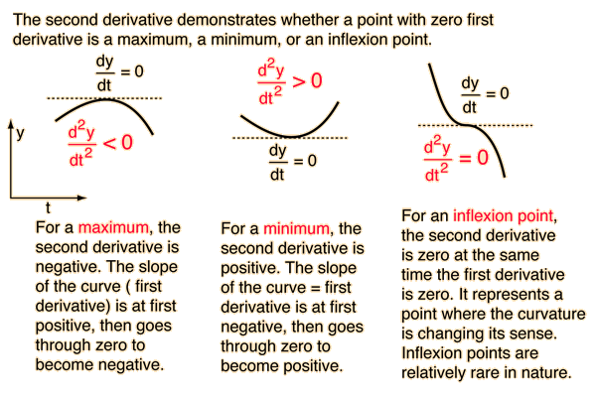
Optimization
Simply means finding the maximum or minimum of a function

Slide 35
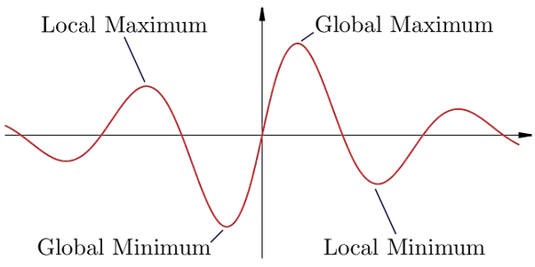
Local and Global Minima & Maxima

Slide 36
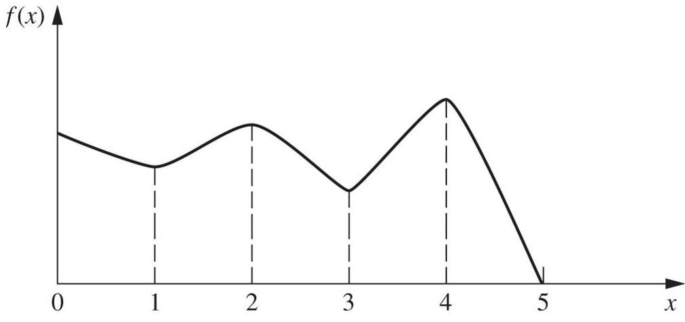
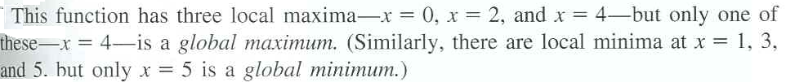
A local maximum need not be a global maximum
C
A
B
D
E
F

Slide 37
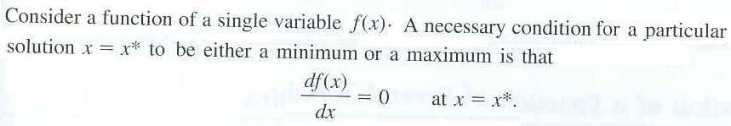


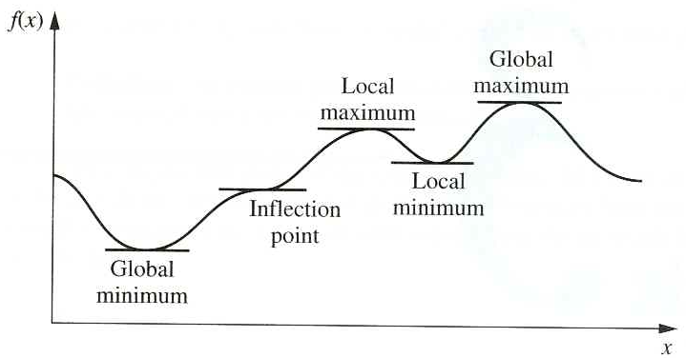
Classical Optimization Methods
Unconstrained optimization of a function of a single variable
Unconstrained optimization of a function of a single variable
If
(If f (x) is strictly convex in the vicinity of x*, is the necessary and sufficient condition for the solution x = x* to be a local minimum)
Global minimum: point A
Global maximum: point E
D
E
B
C
If f (x) is strictly convex everywhere, there is only one local minimum, which is the global minimum
A

Slide 38

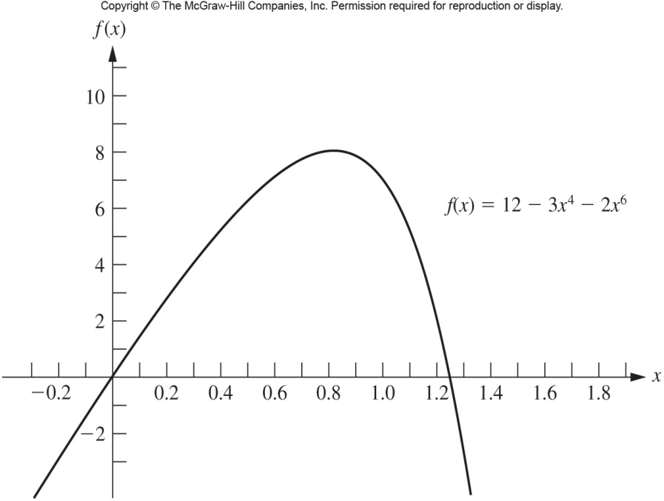
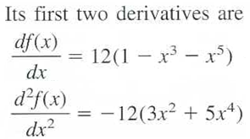




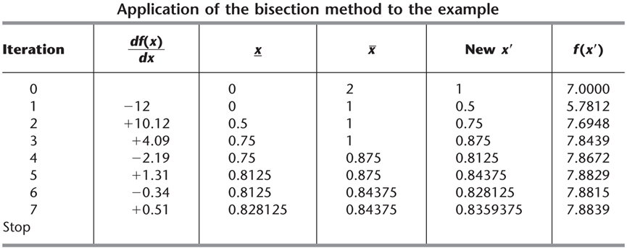

Example:

Slide 39
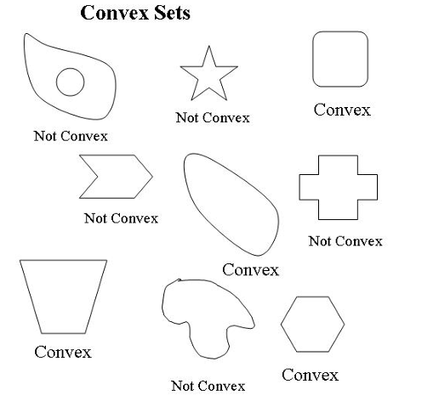
Why are convex sets important to study optimization ?
Definition of a convex set. A set S in R^{n} is said to be convex if for each x₁, x₂ ∈ S, the line segment
λx₁ + (1-λ)x₂ for λ ∈ (0,1) belongs to S. This says that all points on a line connecting two points in the set are in the set. Or lie within or on the set

Slide 40
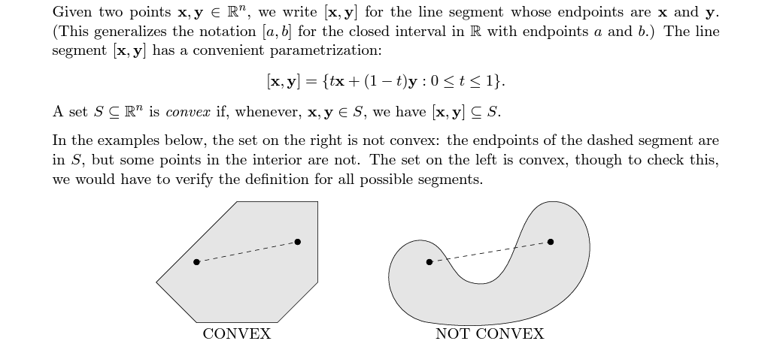
Convexity

Slide 41
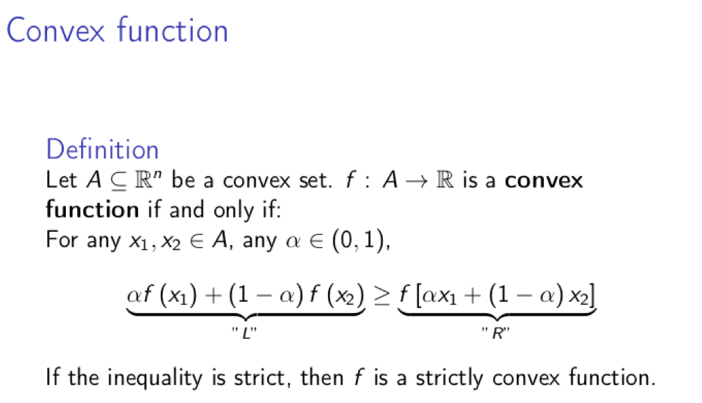
Prove Convexity of a function

Slide 42
Properties of Convex Sets
They are easy to optimize or easy to find maxima and minima in these functions
Intersections of convex sets are convex sets. The intersection of a finite or infinite number of convex sets is convex. Figure 2 contains some examples of convex set intersections.
Addition of Convex Sets is a Convex Set
Half spaces of convex sets are convex sets
A closed, convex set is the intersection of the half spaces that support it. This is illustrated in figure. We can then find a convex set by finding the infinite intersection of half-spaces which support it.

Slide 43
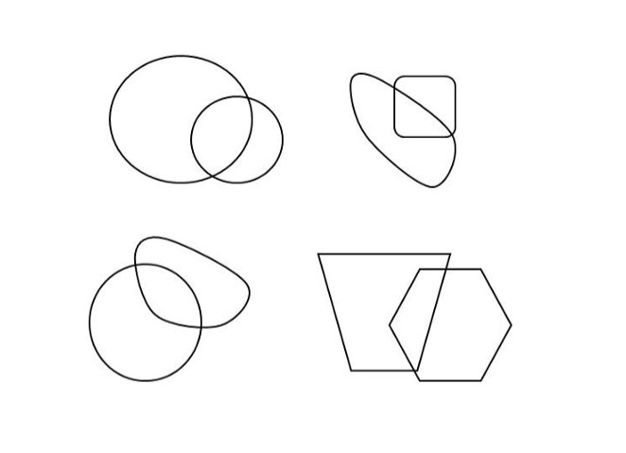
Intersections of Convex Sets

Slide 44
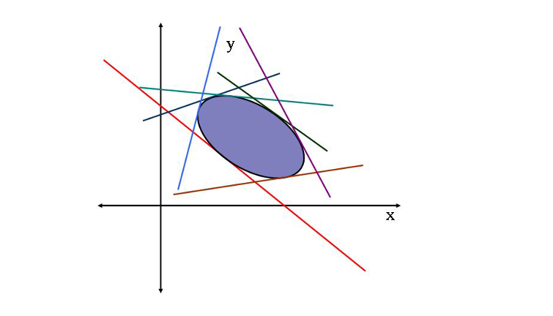
Minkowski’s Theorem
Hyperplanes

Slide 45

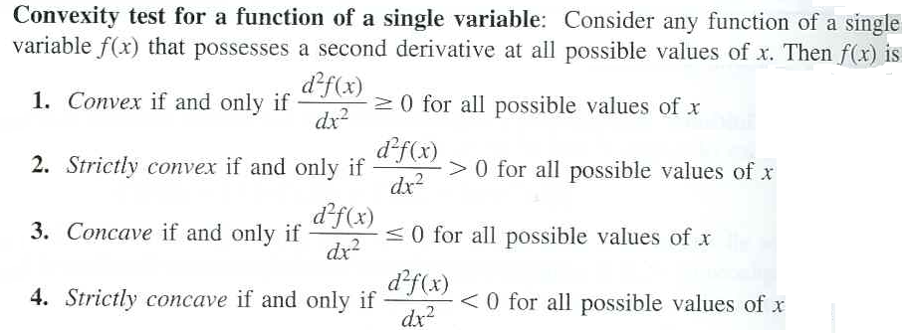
The geometric interpretation indicates that f (x) is convex if it “bend upward”.
To be more precise, if f (x) possesses a second derivative everywhere, then f (x) is convex if and only if for all possible values of x
In terms of the second derivative of the function, the convexity test is summarized below.

Slide 46
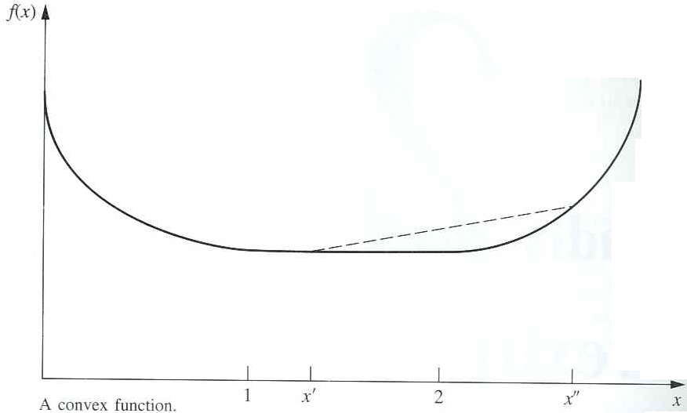
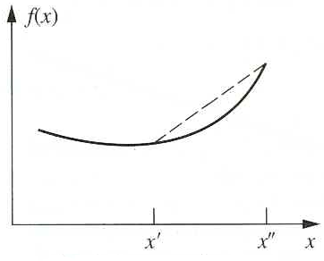
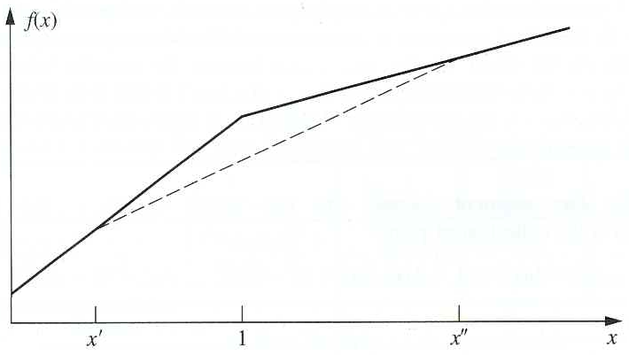
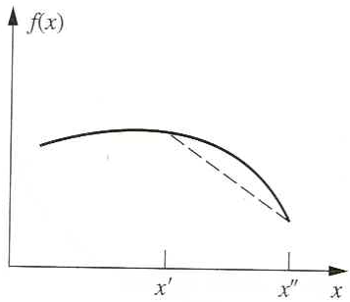
M
N
A convex function
A strictly convex function
T
A concave function
A strictly concave function

Slide 47
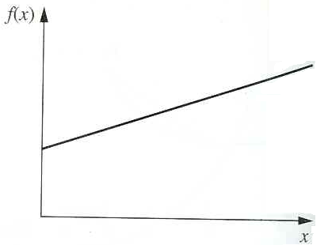
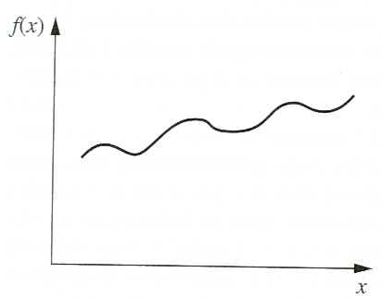
A function that is both convex and concave
A function that is neither convex nor concave

Slide 48
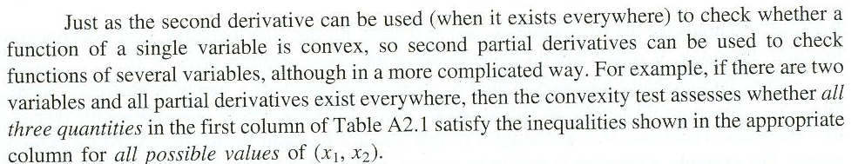
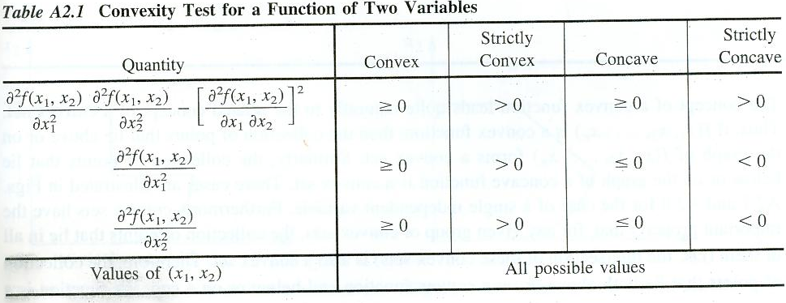

Slide 49
